Slide 1
Presentation title
Mirjam Nilsson

Slide 2
Agenda
Introduction
3
Primary goals
4
Areas of growth
5
Timeline
10
Summary
13

Slide 3
Introduction
3
At Contoso, we empower organizations to foster collaborative thinking to further drive workplace innovation. By closing the loop and leveraging agile frameworks, we help business grow organically and foster a consumer-first mindset.

Slide 4
Primary goals

Slide 5
Areas of growth
 | B2B | Supply chain | ROI | E-commerce
Q1 | 4.5 | 2.3 | 1.7 | 5.0
Q2 | 3.2 | 5.1 | 4.4 | 3.0
Q3 | 2.1 | 1.7 | 2.5 | 2.8
Q4 | 4.5 | 2.2 | 1.7 | 7.0

Slide 6
Business opportunities are like buses. There's always another one coming.
Richard Branson

Slide 7



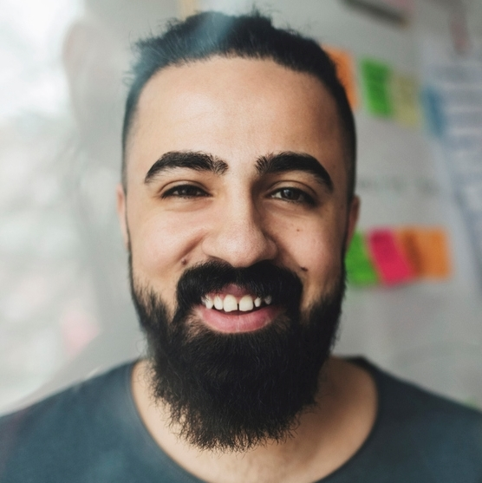
Our team
Takuma Hayashi
Mirjam Nilsson
President
Chief Executive Officer
Flora Berggren
Rajesh Santoshi
Chief Operations Officer
VP Marketing

Slide 8



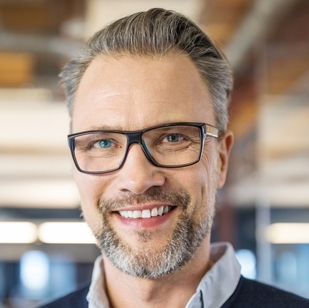



Our extended team
Takuma Hayashi
Mirjam Nilsson
Flora Berggren
Rajesh Santoshi
President
Chief Executive Officer
Chief Operations Officer
VP Marketing
Graham Barnes
Rowan Murphy
Elizabeth Moore
Robin Kline
VP Product
SEO Strategist
Product Designer
Content Developer

Slide 9
Plan for product launch
Deploy strategic networks with compelling e-business needs
Planning
Synergize scalable e-commerce
Marketing
Disseminate standardized metrics
Design
Coordinate e-business applications
Foster holistically superior methodologies
Launch
Strategy

Slide 10
Timeline
Sep
Nov
Jan
Mar
May
Synergize scalable
e-commerce
Disseminate standardized metrics
Coordinate
e-business applications
Foster holistically superior methodologies
Deploy strategic networks with compelling
e-business needs

Slide 11
Areas of focus
B2B market
scenarios
Cloud-based
opportunities
Develop winning strategies to keep ahead of the competition​
Capitalize on low-hanging fruit to identify a ballpark value​
Visualize customer directed convergence
Iterative approaches to corporate strategy
Establish a management framework from the inside

Slide 12
How we get there
ROI
Niche markets
Supply chains
Envision multimedia-based expertise and cross-media growth strategies​
Visualize quality intellectual capital​
Engage worldwide methodologies with web-enabled technologies​
Pursue scalable customer service through sustainable strategies​
Engage top-line web services with
cutting-edge
deliverables
Cultivate one-to-one customer
service with robust
ideas​
Maximize timely deliverables
for real-
time schemas

Slide 13
Summary
At Contoso, we believe in giving 110%. By using our next-generation data architecture, we help organizations virtually manage agile workflows. We thrive because of our market knowledge and great team behind our product. As our CEO says, "Efficiencies will come from proactively transforming how we do business."​
​

Slide 14
Thank you
Mirjam Nilsson​
mirjam@contoso.com
www.contoso.com

